Slide 1
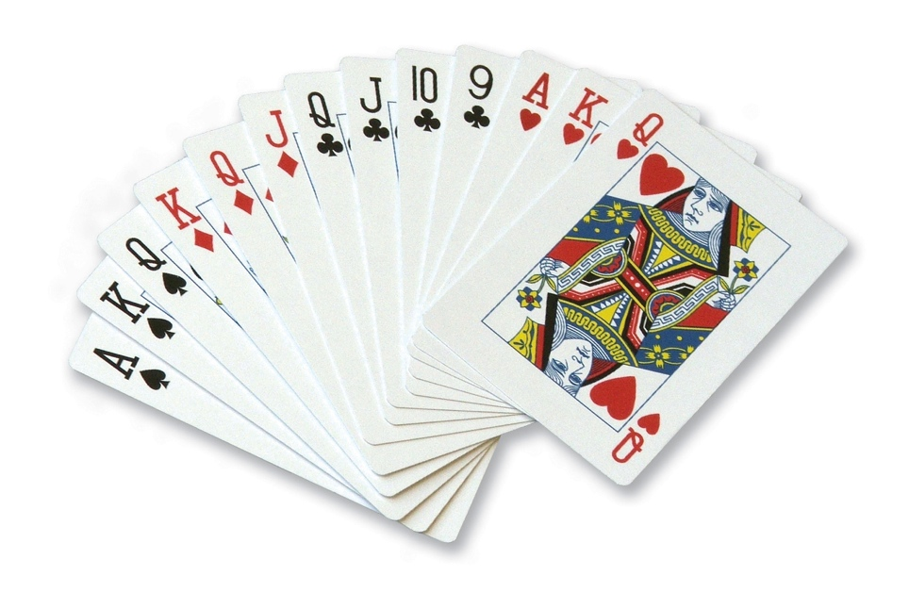
CS3343 Software Engineering Practice Week 1 Exercises on PokerGame
PokerGame
1

Slide 2
Objective
To install and configure programming environment
Tool: Eclipse and Plugins following the guide

Slide 3
Activities
Review the Eclipse Plugin Guide on Project Website
https://canvas.cityu.edu.hk/files/4627565/download?download_frd=1
JUnit Testing
Exercises 1

Slide 4
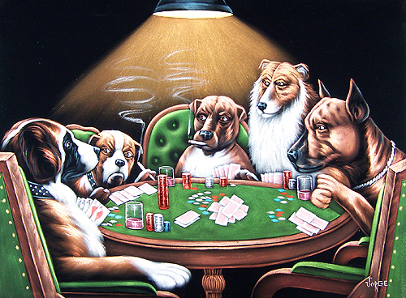
Case Study – A Simple Poker Game
Background
A player is given a hand, namely 5 distinct poker cards, from a deck of 52 distinct cards
13 cards: A, 2, 3, 4, 5, 6, 7, 8, 9, X, J, Q, and K
(X = 10)
4 suits: club (C), heart (H), spade (S), and diamond (D)
4
Notes:
A full house, also known as a full boat, is a hand such as 3♣ 3♠ 3♦ 6♣ 6♥, that contains three matching cards of one rank and two matching cards of another rank.
Software Design
4

Slide 5
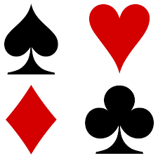
4 Suits
Club (C), Heart (H), diamond (D) and Spade (S)

Slide 6
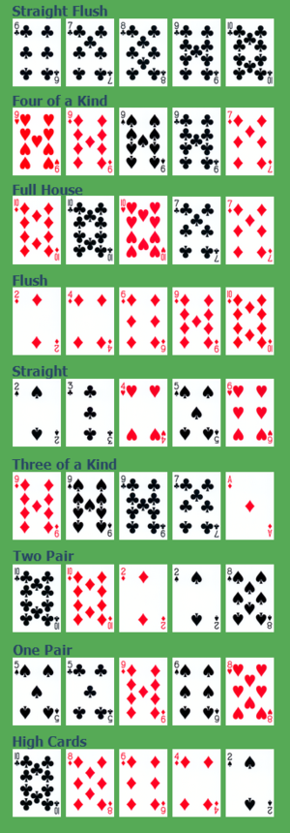
Exercise 1
Study the Java implementation of Poker Game
See the next slide and save the file as “Poker.java”.
Download from Canvas website and Setup the project.
Functional Requirements:
To check whether a hand of 5 cards is a full house
Full house: three cards of one rank accompanied by two of another
How do you implement this function?
6
Notes:
Software Design
6

Slide 7
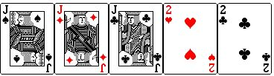
Full House (3+2)
A full house is three of one card, and two of another card. So it can be three eights and two six's, three nines and two fours, or any other combination that you can pull.

Slide 8
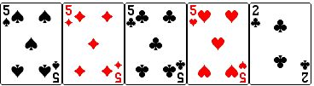
Four of a Kind (4+1)
While four of a kind is incredibly tough to land, it's still possible. You have to get all four of the same card in the deck.

Slide 9
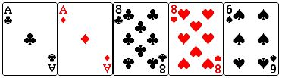
Two Pair (2+2+1)
As you can imagine, it is just having two different pairs.

Slide 10
Poker.java (not “poker.java”!)

